Slide 1
Class 2: Customer and Distribution Partner Engagement and the Link to Employees
Key issues
Audience attributes
Engagement-performance connection.

Slide 2
Refresher: Employee
Engagement Principles
A New Discipline Offering Significant Rewards For First and Early Movers
A Holistic Approach that Requires Enterprise-Wide Integration and Commitment, and Involves all Key Constituents Outside the Organization
Part of and Aligned with the Corporate Strategy and Planning
Leverages All Peoples’ Desire to be Engaged
Drives Higher Performance and Better Business Outcomes
Must Tap Emotions to Secure the Deep Commitment Required of Employees, Customers, Partners, Suppliers and Others
Is Driven by Appreciation – Incentives and Recognition
Is Sustained Through Measurement and Continuous Improvement
Notes:
2

Slide 3
Customer and Channel Partner Engagement and Link to Employees.

Slide 4
What is Customer Engagement?
“Yes” Point
“Wow!” Point
Value Value Value Value
Value
Worthless
Perfect
Business Value
Personal & Relationshi p Value
Customer Satisfaction
Customer Engagement

Slide 5
Real Engagement is Emotional
Source: Gallup
“Customers who are fully engaged represent an average 23% premium in terms of share of wallet, profitability, revenue, and
relationship growth than the average customer.” ~ Gallup

Slide 6
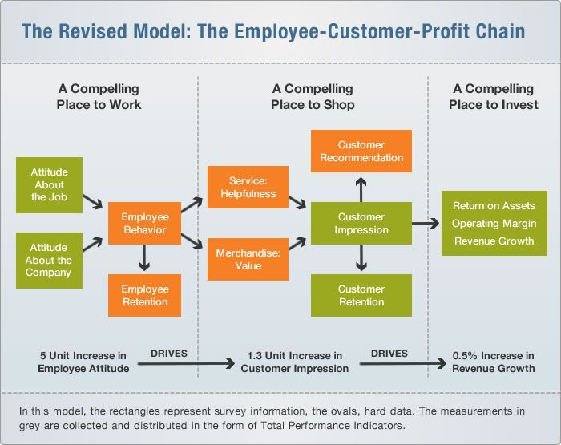
The Connection is Well-Established

Slide 7
Greater Returns by Combining Customer and Employee Engagement Found by Classic Gallup Study
Source: Gallup, Human Sigma, 2007

Slide 8
Gallup’s report identifies six areas that world-class organizations focus on to fully engage their customers:
Emotional Attachment:
Most profitable customers have strong emotional bonds that must be honored and strengthened.
How to Engage Customers
Moving Beyond Satisfaction:Simply satisfying customers is not enough.
Key Touchpoints:
Every customer interaction makes that customer more or less engaged.
Rewards & Recognition
Encourage customers, salespeople, customer service reps and other employees to share ideas and communicate
All customer touchpoints must be measured and managed. Branding, for example, should be consistent whether aimed at employees or customers (indeed, it should be aimed at both simultaneously).
Brand Alignment:
Local Variation:
Strong customer relationships must be managed locally. Everyone is responsible for the customer experience.

Slide 9
Integrated Employee, Customer & Channel Engagement

Slide 10
Requirements for Channel Engagement
Recruitment
Enablement Management Reward

Slide 11
Common Characteristics

Slide 12
The correlation between Engagement of all forms and better business outcomes is beyond refute
Most organizations focused on Engagement have room for improvement. Very few extend their efforts beyond employees and customers.
Assess Engagement early and often using Gallup, NPS, or other surveys.
Final Thoughts
Encourage joint ownership of Engagement
Take action with your assessment data
Regularly measure improvements or setbacks
Get feedback from employees and embrace the power of Engagement

Slide 13
Summary Class 2
Beyond the business relationship, personal relationships must be developed that engage customers.
Satisfied customers are no more likely to be retained than unsatisfied customers: a “wow” factor is necessary.
Engaged customers are more likely to stay and spend more.
Engaged employees are more likely to engage customers, who when engaged, are more likely to stay and spend, which in turn drives revenue and profit.
Engaged employees and customers return, on average,
3.4 times more than in
organizations where neither are engaged.
The important connection between engaged customers and engaged employees is well-established.
Channel partners are a key constituent for many organizations. They are often a main or even a sole connection to the customers.
To engage channel partners you must select them carefully, support them, manage the relationship and recognize and reward them.
Channel partners should be engaged just like customers and employees – emotionally.

Slide 14
Sample Exam Questions
What are key drivers of customer and channel partner engagement?
What relationships exist between the engagement of channel partners and customers?
What is the relationship between customer, employee, and channel engagement?

